Slide 1
Year of Mercy
December 2015 to November 2016

Slide 2
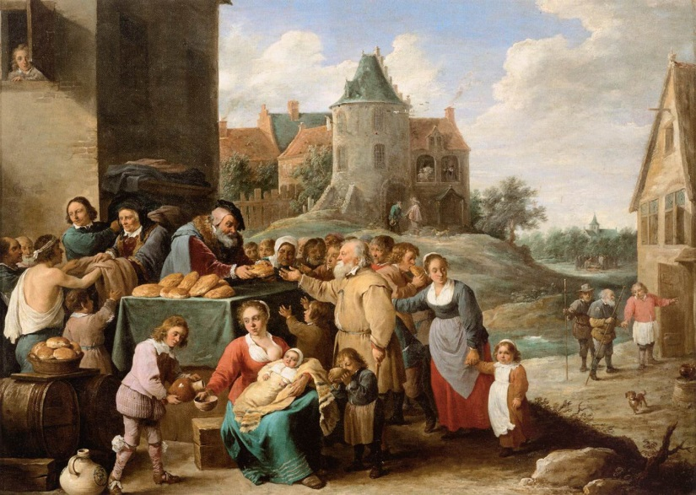
7 Corporal Works of Mercy
Feed the hungry,
Drink to the Thirsty,
Give clothes to those without,
Find homes for the homeless,
Think of those who are ill,
Think of those wrongfully imprisoned
Remember those who have died
7 Spiritual Works of Mercy
Spread the Good News of God’s love,
Show others how to behave well
Help those who have done wrong
Care for those who are unhappy
Be forgiving
Start each day afresh
Pray for the living and the dead

Slide 3
A little bit of mercy makes the world less cold and more just.
Pope Francis

Slide 4
Lord Jesus, you are loving and your mercy endures forever.
You are compassionate and gracious, slow to anger, overflowing with love and faithfulness.
Turn to me and have mercy on me, forgive my sins and grant me the grace to live the life worthy of your praise.
We ask this in the name of Jesus Christ our Lord, Amen.

